Slide 1


Deep learning-based Lane Detection in Foggy weather Conditions
Final Presentation
Project Advisors:
Dr Rahul Rai (rrai@clemson.edu)
Shengli Xu (shenglx@clemson.edu)
Team Members:
Pranava Swaroopa(pswaroo@clemson.edu)
Sanskruti Jadhav (sanskrj@clemson.edu)
Siddharth Joshi (sajoshi@clemson.edu)

Slide 2
Motivation
According to NHTSA the fatality and fatality rate per 100 million miles traveled by the vehicle, is of the order of 30,000-40,000. In high-speed scenarios, human reaction is often not fast enough or accurate enough to avoid all forms of injury. Most of the collision that arises is due to some form of human error. (Fatality Analysis Reporting System (FARS) | NHTSA)
Detecting and following lines using sensors like Camera, LiDAR, RADAR is difficult in inclement weather conditions.
Using a network that is specifically trained with worse weather conditions help in accurate lane following algorithms
Notes:
Editorial Guidelines on Bullets:
1. Vertical lists are best introduced by a grammatically complete sentence followed by a colon. No periods
are required at the end of entries unless at least one entry is a complete sentence, in which case a period
is necessary at the end of each entry.
Example: A university can be judged by three measures:
· The quality of its students
· The quality of it faculty
· The quality of its infrastructure
2. If a list completes the sentence that introduces it, items begin with lowercase letters, commas or semicolons
(if individual items contain commas) are used to separate each item, and the last item ends with a period.
Note that the introductory clause does not end with a colon.
Example: A university can be judged by
· the quality of its students,
· the quality of its faculty,
· the quality of its infrastructure.
3. Avoid mixing sentence and nonsentence items in a bulleted list.
2

Slide 3
Computation Platform and dependencies
HPC: Palmetto Cluster Clemson University
Compute Node:
GPU: Tesla V100
RAM 125gb
Cores 28
Package Dependencies:​
Python 3.6.4​
Tensorflow 2.4.0​
Pickle 5​
Open CV​
Numpy
Notes:
Editorial Guidelines on Bullets:
1. Vertical lists are best introduced by a grammatically complete sentence followed by a colon. No periods
are required at the end of entries unless at least one entry is a complete sentence, in which case a period
is necessary at the end of each entry.
Example: A university can be judged by three measures:
· The quality of its students
· The quality of it faculty
· The quality of its infrastructure
2. If a list completes the sentence that introduces it, items begin with lowercase letters, commas or semicolons
(if individual items contain commas) are used to separate each item, and the last item ends with a period.
Note that the introductory clause does not end with a colon.
Example: A university can be judged by
· the quality of its students,
· the quality of its faculty,
· the quality of its infrastructure.
3. Avoid mixing sentence and nonsentence items in a bulleted list.
3

Slide 4
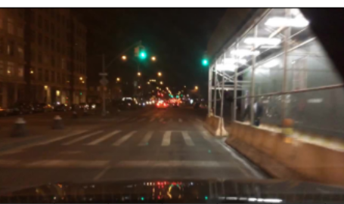
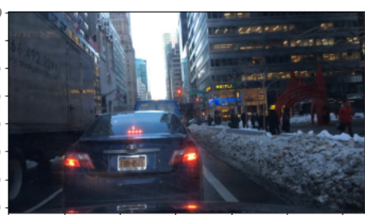
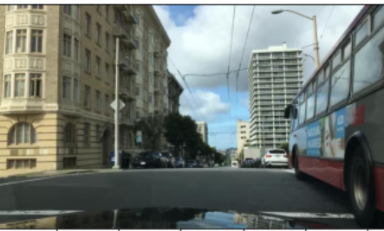
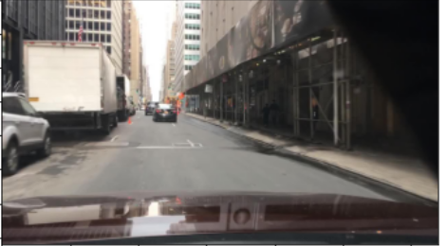
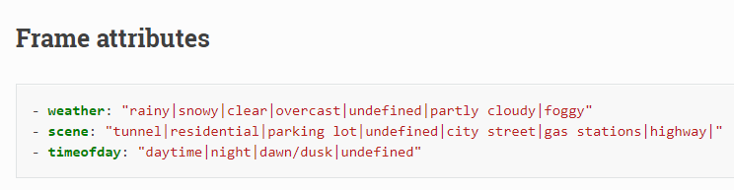

Dataset
Drivable area segmentation BDD100K consists of
70,000/10,000/20,000 of training, Validation, Testing
Labels – Masks, Polygons, Colormaps
Notes:
Editorial Guidelines on Bullets:
1. Vertical lists are best introduced by a grammatically complete sentence followed by a colon. No periods
are required at the end of entries unless at least one entry is a complete sentence, in which case a period
is necessary at the end of each entry.
Example: A university can be judged by three measures:
· The quality of its students
· The quality of it faculty
· The quality of its infrastructure
2. If a list completes the sentence that introduces it, items begin with lowercase letters, commas or semicolons
(if individual items contain commas) are used to separate each item, and the last item ends with a period.
Note that the introductory clause does not end with a colon.
Example: A university can be judged by
· the quality of its students,
· the quality of its faculty,
· the quality of its infrastructure.
3. Avoid mixing sentence and nonsentence items in a bulleted list.
4

Slide 5
Dataset
Images Attribute | Number
Partly Cloudy | 4881
Rainy | 5070
Snowy | 5549
Foggy | 130
Image and Label Sizes
Images | Labels - Colormaps
(15630,720,1280,3) | (15630,720,1230
Notes:
Editorial Guidelines on Bullets:
1. Vertical lists are best introduced by a grammatically complete sentence followed by a colon. No periods
are required at the end of entries unless at least one entry is a complete sentence, in which case a period
is necessary at the end of each entry.
Example: A university can be judged by three measures:
· The quality of its students
· The quality of it faculty
· The quality of its infrastructure
2. If a list completes the sentence that introduces it, items begin with lowercase letters, commas or semicolons
(if individual items contain commas) are used to separate each item, and the last item ends with a period.
Note that the introductory clause does not end with a colon.
Example: A university can be judged by
· the quality of its students,
· the quality of its faculty,
· the quality of its infrastructure.
3. Avoid mixing sentence and nonsentence items in a bulleted list.
5

Slide 6

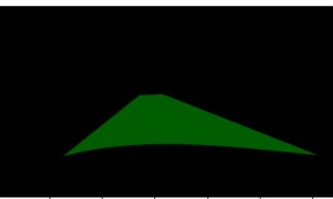
Data Processing
Huge dataset of 15560 images in jpg format and Labels in PNG format
Processed labels converting to HSV images to remove dual labels and only focusing on one type of label (Green Channel)
Normalizing and Resizing the datasets
Saving NumPy Arrays to facilitate reusing and avoiding long processing time
Dead Kernel issues
Notes:
Editorial Guidelines on Bullets:
1. Vertical lists are best introduced by a grammatically complete sentence followed by a colon. No periods
are required at the end of entries unless at least one entry is a complete sentence, in which case a period
is necessary at the end of each entry.
Example: A university can be judged by three measures:
· The quality of its students
· The quality of it faculty
· The quality of its infrastructure
2. If a list completes the sentence that introduces it, items begin with lowercase letters, commas or semicolons
(if individual items contain commas) are used to separate each item, and the last item ends with a period.
Note that the introductory clause does not end with a colon.
Example: A university can be judged by
· the quality of its students,
· the quality of its faculty,
· the quality of its infrastructure.
3. Avoid mixing sentence and nonsentence items in a bulleted list.
6

Slide 7
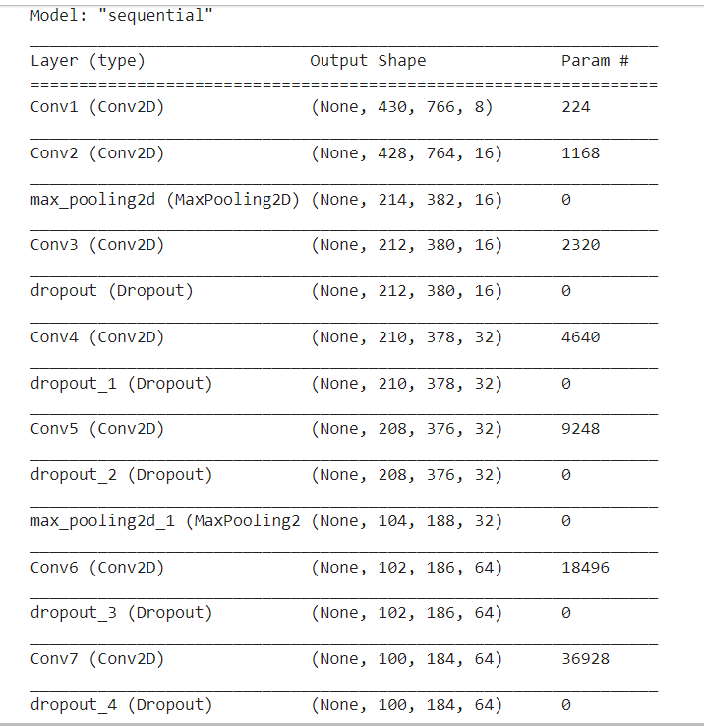
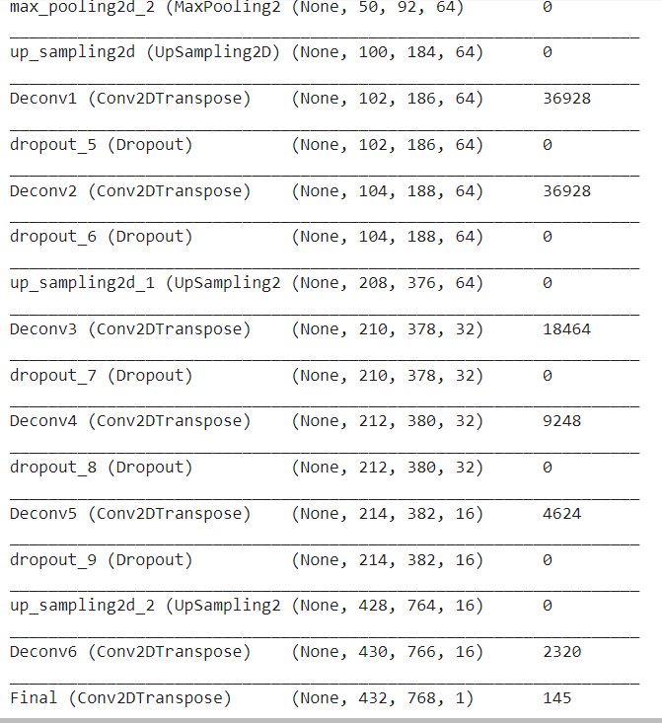
OPTIMUM MODEL FRAMEWORK
Notes:
Editorial Guidelines on Bullets:
1. Vertical lists are best introduced by a grammatically complete sentence followed by a colon. No periods
are required at the end of entries unless at least one entry is a complete sentence, in which case a period
is necessary at the end of each entry.
Example: A university can be judged by three measures:
· The quality of its students
· The quality of it faculty
· The quality of its infrastructure
2. If a list completes the sentence that introduces it, items begin with lowercase letters, commas or semicolons
(if individual items contain commas) are used to separate each item, and the last item ends with a period.
Note that the introductory clause does not end with a colon.
Example: A university can be judged by
· the quality of its students,
· the quality of its faculty,
· the quality of its infrastructure.
3. Avoid mixing sentence and nonsentence items in a bulleted list.
7

Slide 8
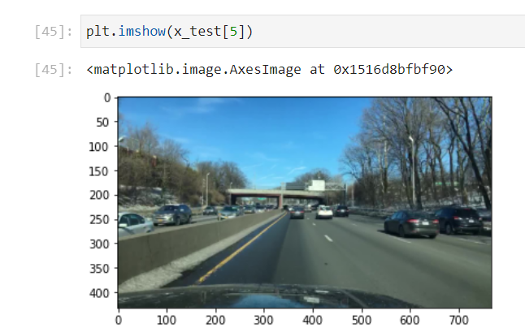
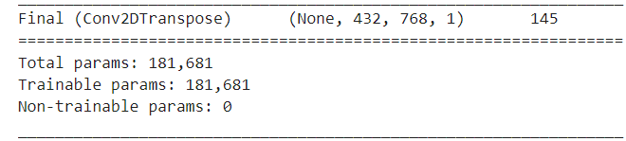
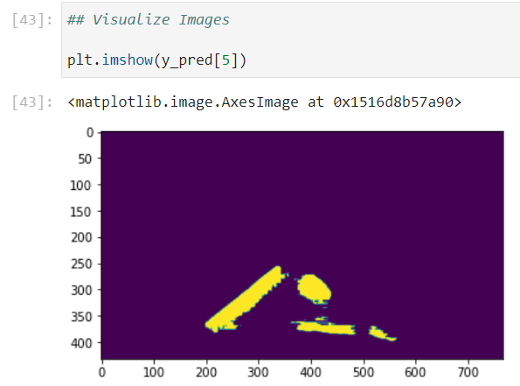
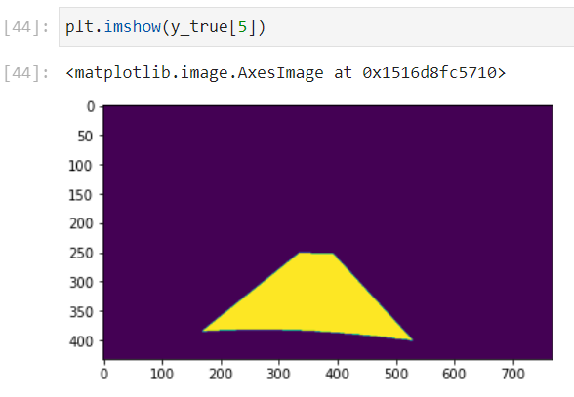
RESULTS
Notes:
Editorial Guidelines on Bullets:
1. Vertical lists are best introduced by a grammatically complete sentence followed by a colon. No periods
are required at the end of entries unless at least one entry is a complete sentence, in which case a period
is necessary at the end of each entry.
Example: A university can be judged by three measures:
· The quality of its students
· The quality of it faculty
· The quality of its infrastructure
2. If a list completes the sentence that introduces it, items begin with lowercase letters, commas or semicolons
(if individual items contain commas) are used to separate each item, and the last item ends with a period.
Note that the introductory clause does not end with a colon.
Example: A university can be judged by
· the quality of its students,
· the quality of its faculty,
· the quality of its infrastructure.
3. Avoid mixing sentence and nonsentence items in a bulleted list.
8

Slide 9
Optimum Model Hyperparameters
Sr. No | Hyperparameter | Values
1 | Image size | 60% of original value ( 432, 768, 3)
2 | Training dataset: Testing dataset: | 12504 images 3126 images
3 | Batch size | 32
4 | Epoch | 10
5 | Optimizer | Adam (learning rate -0.001)
6 | Loss Function | Mean Squared Error
7 | Activation Function | ReLU
8 | Layer sizes | 7 Convolution Layers 6 Deconvolution Layers 3 max pooling Layers 9 Drop out Layers 2 Up-sampling Layers
Notes:
Editorial Guidelines on Bullets:
1. Vertical lists are best introduced by a grammatically complete sentence followed by a colon. No periods
are required at the end of entries unless at least one entry is a complete sentence, in which case a period
is necessary at the end of each entry.
Example: A university can be judged by three measures:
· The quality of its students
· The quality of it faculty
· The quality of its infrastructure
2. If a list completes the sentence that introduces it, items begin with lowercase letters, commas or semicolons
(if individual items contain commas) are used to separate each item, and the last item ends with a period.
Note that the introductory clause does not end with a colon.
Example: A university can be judged by
· the quality of its students,
· the quality of its faculty,
· the quality of its infrastructure.
3. Avoid mixing sentence and nonsentence items in a bulleted list.
9

Slide 10
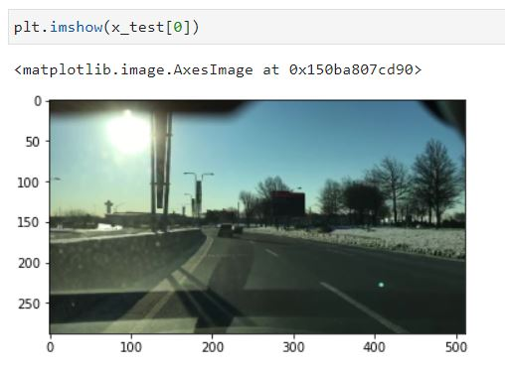
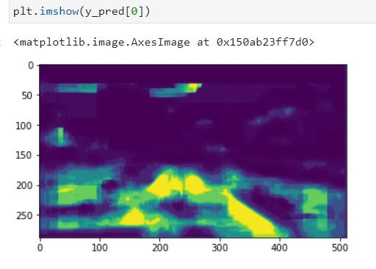
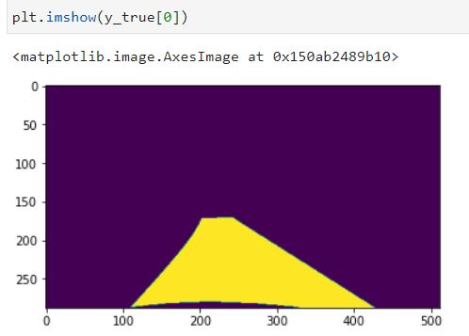
Poor Model Result
Hyper-params :
# Epochs – 10
Batch size –16
No. of Layers –22
Learning rate –0.01
Notes:
Editorial Guidelines on Bullets:
1. Vertical lists are best introduced by a grammatically complete sentence followed by a colon. No periods
are required at the end of entries unless at least one entry is a complete sentence, in which case a period
is necessary at the end of each entry.
Example: A university can be judged by three measures:
· The quality of its students
· The quality of it faculty
· The quality of its infrastructure
2. If a list completes the sentence that introduces it, items begin with lowercase letters, commas or semicolons
(if individual items contain commas) are used to separate each item, and the last item ends with a period.
Note that the introductory clause does not end with a colon.
Example: A university can be judged by
· the quality of its students,
· the quality of its faculty,
· the quality of its infrastructure.
3. Avoid mixing sentence and nonsentence items in a bulleted list.
10

Slide 11
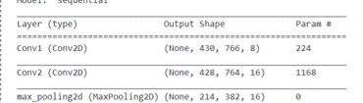
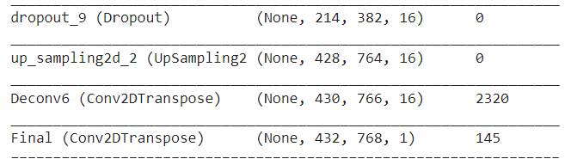
Our Contribution
Adding Convolutional layers with more filters at the beginning proved to effective for feature learning
Corresponding Deconvolution Layers and Up-sampling Layers
Training Image Size 60 % (432,768) was good enough compared to basic image size (720,1280)
Notes:
Editorial Guidelines on Bullets:
1. Vertical lists are best introduced by a grammatically complete sentence followed by a colon. No periods
are required at the end of entries unless at least one entry is a complete sentence, in which case a period
is necessary at the end of each entry.
Example: A university can be judged by three measures:
· The quality of its students
· The quality of it faculty
· The quality of its infrastructure
2. If a list completes the sentence that introduces it, items begin with lowercase letters, commas or semicolons
(if individual items contain commas) are used to separate each item, and the last item ends with a period.
Note that the introductory clause does not end with a colon.
Example: A university can be judged by
· the quality of its students,
· the quality of its faculty,
· the quality of its infrastructure.
3. Avoid mixing sentence and nonsentence items in a bulleted list.
11

Slide 12
Hyperparameter Tuning
No | # Epochs | Image Resize Factor | Batch Size | Learning Rate | mIoU | Time (s) | Final Loss
1 | 10 | 0.6 | 8 | 0.001 | 0.41 | 1160 | 0.118
2 | 10 | 0.6 | 8 | 0.0001 | 0.43 | 1170 | 0.157
3 | 10 | 0.6 | 8 | 0.1 | 0.44 | 1165 | 0.121
4 | 10 | 0.6 | 16 | 0.001 | 0.44 | 2152 | 0.068
5 | 10 | 0.6 | 32 | 0.001 | 0.44 | 1230 | 0.0705
6 | 30 | 0.6 | 32 | 0.0001 | 0.4415 | 1490 | 0.0713
Notes:
Editorial Guidelines on Bullets:
1. Vertical lists are best introduced by a grammatically complete sentence followed by a colon. No periods
are required at the end of entries unless at least one entry is a complete sentence, in which case a period
is necessary at the end of each entry.
Example: A university can be judged by three measures:
· The quality of its students
· The quality of it faculty
· The quality of its infrastructure
2. If a list completes the sentence that introduces it, items begin with lowercase letters, commas or semicolons
(if individual items contain commas) are used to separate each item, and the last item ends with a period.
Note that the introductory clause does not end with a colon.
Example: A university can be judged by
· the quality of its students,
· the quality of its faculty,
· the quality of its infrastructure.
3. Avoid mixing sentence and nonsentence items in a bulleted list.
12

Slide 13
Hyperparameter Tuning
Hyperparameters Selected:
Kernel Size – (3,3) & (5,5)
Epoch – 10, 6, 30
Learning Rate – 0.001, 0.1, 0.0001, 0.2
Batch Size – 8, 16, 32
Input Image Resizing – 60% of Original, 40% of original
Notes:
Editorial Guidelines on Bullets:
1. Vertical lists are best introduced by a grammatically complete sentence followed by a colon. No periods
are required at the end of entries unless at least one entry is a complete sentence, in which case a period
is necessary at the end of each entry.
Example: A university can be judged by three measures:
· The quality of its students
· The quality of it faculty
· The quality of its infrastructure
2. If a list completes the sentence that introduces it, items begin with lowercase letters, commas or semicolons
(if individual items contain commas) are used to separate each item, and the last item ends with a period.
Note that the introductory clause does not end with a colon.
Example: A university can be judged by
· the quality of its students,
· the quality of its faculty,
· the quality of its infrastructure.
3. Avoid mixing sentence and nonsentence items in a bulleted list.
13

Slide 14
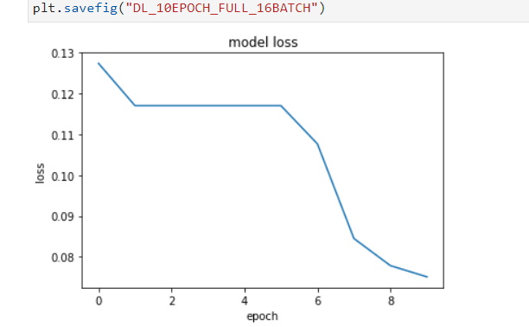
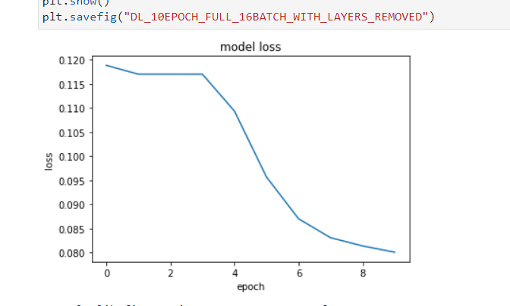
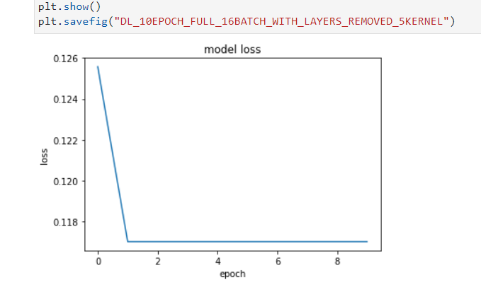
INITIAL TRIAL RESULTS
Notes:
Editorial Guidelines on Bullets:
1. Vertical lists are best introduced by a grammatically complete sentence followed by a colon. No periods
are required at the end of entries unless at least one entry is a complete sentence, in which case a period
is necessary at the end of each entry.
Example: A university can be judged by three measures:
· The quality of its students
· The quality of it faculty
· The quality of its infrastructure
2. If a list completes the sentence that introduces it, items begin with lowercase letters, commas or semicolons
(if individual items contain commas) are used to separate each item, and the last item ends with a period.
Note that the introductory clause does not end with a colon.
Example: A university can be judged by
· the quality of its students,
· the quality of its faculty,
· the quality of its infrastructure.
3. Avoid mixing sentence and nonsentence items in a bulleted list.
14

Slide 15
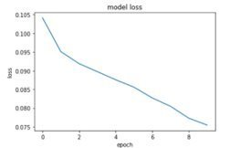
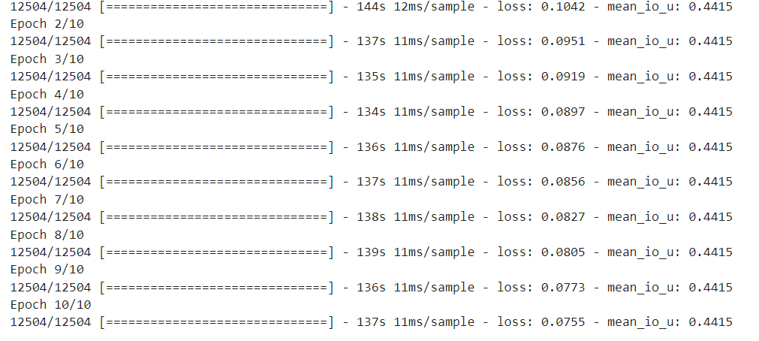
Final Model Losses and Mean_IoU
Final Loss 0.0755
mIOU = 0.4415
Notes:
Editorial Guidelines on Bullets:
1. Vertical lists are best introduced by a grammatically complete sentence followed by a colon. No periods
are required at the end of entries unless at least one entry is a complete sentence, in which case a period
is necessary at the end of each entry.
Example: A university can be judged by three measures:
· The quality of its students
· The quality of it faculty
· The quality of its infrastructure
2. If a list completes the sentence that introduces it, items begin with lowercase letters, commas or semicolons
(if individual items contain commas) are used to separate each item, and the last item ends with a period.
Note that the introductory clause does not end with a colon.
Example: A university can be judged by
· the quality of its students,
· the quality of its faculty,
· the quality of its infrastructure.
3. Avoid mixing sentence and nonsentence items in a bulleted list.
15

Slide 16
Conclusion
Our project started with gathering and curating the data, where the data curation was the most tedious task
Based on the results we achieved our model is not robust enough but gives you an idea about where the lane is and has a scope to lot of improvement
Notes:
Editorial Guidelines on Bullets:
1. Vertical lists are best introduced by a grammatically complete sentence followed by a colon. No periods
are required at the end of entries unless at least one entry is a complete sentence, in which case a period
is necessary at the end of each entry.
Example: A university can be judged by three measures:
· The quality of its students
· The quality of it faculty
· The quality of its infrastructure
2. If a list completes the sentence that introduces it, items begin with lowercase letters, commas or semicolons
(if individual items contain commas) are used to separate each item, and the last item ends with a period.
Note that the introductory clause does not end with a colon.
Example: A university can be judged by
· the quality of its students,
· the quality of its faculty,
· the quality of its infrastructure.
3. Avoid mixing sentence and nonsentence items in a bulleted list.
16

Slide 17
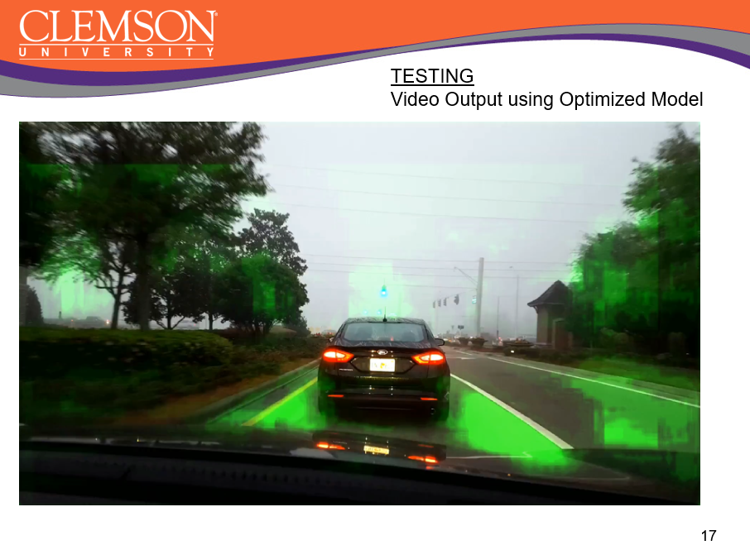
Notes:
Editorial Guidelines on Bullets:
1. Vertical lists are best introduced by a grammatically complete sentence followed by a colon. No periods
are required at the end of entries unless at least one entry is a complete sentence, in which case a period
is necessary at the end of each entry.
Example: A university can be judged by three measures:
· The quality of its students
· The quality of it faculty
· The quality of its infrastructure
2. If a list completes the sentence that introduces it, items begin with lowercase letters, commas or semicolons
(if individual items contain commas) are used to separate each item, and the last item ends with a period.
Note that the introductory clause does not end with a colon.
Example: A university can be judged by
· the quality of its students,
· the quality of its faculty,
· the quality of its infrastructure.
3. Avoid mixing sentence and nonsentence items in a bulleted list.
17

